Slide 1
Section 5.1 Areas of Triangles, Parallelograms, and rectangles
© Copyright all rights reserved to Homework depot: www.BCMath.ca

Slide 2
I) Review: Finding the Area of a Square or Rectangle:
The area of a square or a rectangle can be easy found by multiplying the length and width
One way to perceive the area is to count the number of little 1 by 1 squares in a square or rectangle
Length
Length
Width
Width
Area = Length x Width
Area = Length x Width
There are 12 little units squares in this rectangle
There are 40 little units squares in this rectangle

Slide 3
II) Review #2) Area of a Triangle and Parallelogram:
A triangle is half a rectangle
The area of a triangle is half a rectangle
A parallelogram can be shifted to form a rectangle
The area of a parallelogram is the

Slide 4
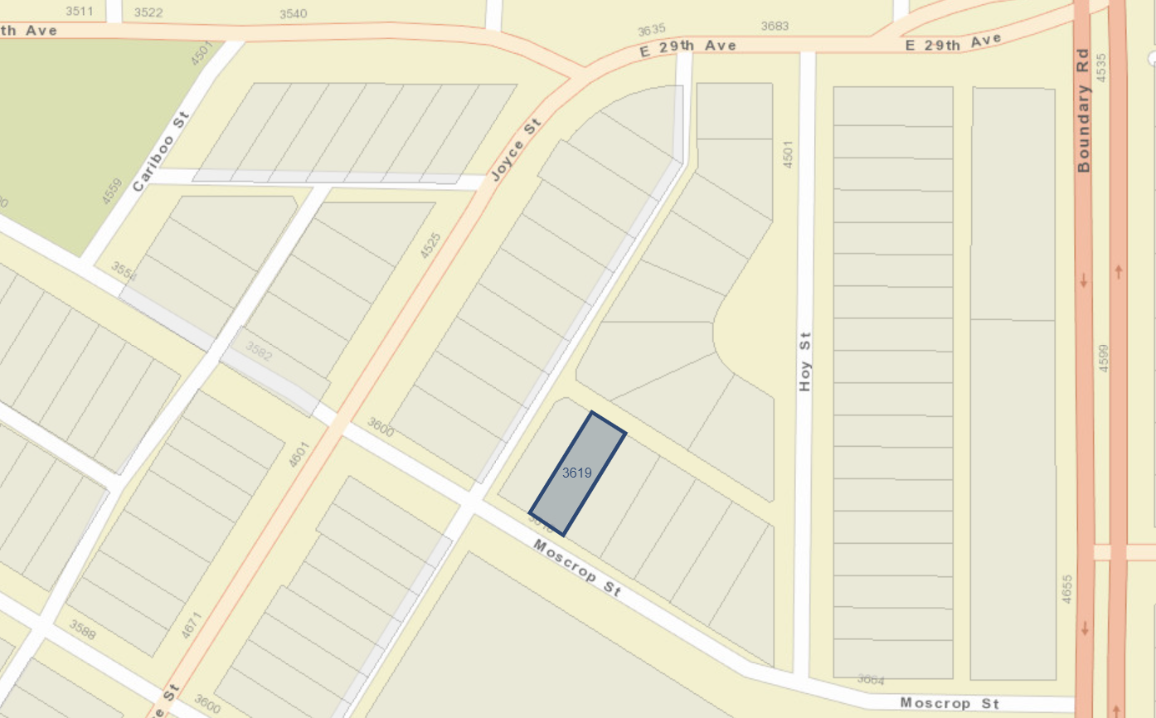
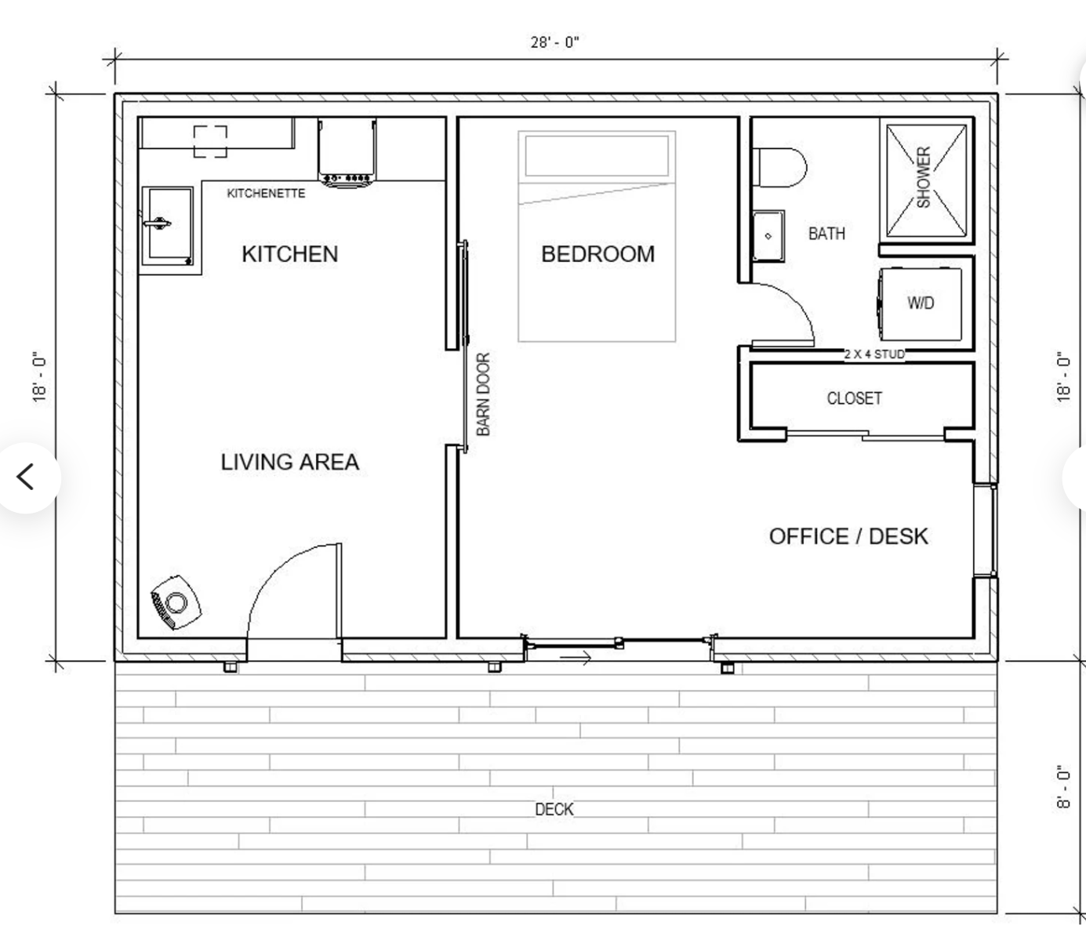
Applications of “Areas”:
In this section, we will look at how to find the “area” of a rectangle, quadrilateral, and triangles
“Area” refers to the amount of space inside a shape
The units for area is in form of units², cm², m² km² depending on which unit is used for measuring the lengths of the shape
Ie: The applications of “area” are everywhere, when purchasing a property, we are usually given a blueprint that shows the area of a floorplan, measured in feet²
to get the area of a floorplan, you can cut it up into smaller rectangles and then get the area of each piece separately
Another application is landvalue assessment: https://www.bcassessment.ca/
Type in your address and then you get a shape of your property line: rectangles, triangles, trapezoids, parallelograms

Slide 5
Ex: Match each solid with the correct formula and then find the area
Square
Circle
Trapezoid
Triangle
Rectangle
Now given the dimensions of each shape, find the area:
Square
Circle
Trapezoid
Triangle
Rectangle
© Copyright all rights reserved to Homework depot: www.BCMath.ca

Slide 6
How to Find the Area of a 2D Shape
One way to find the area of a 2D shape is to use the formula of certain shapes:
If a shape is “irregular” then split it into combinations of regular shapes and then combine the areas
Suppose we are to find the area of the shape below:
Cut the shape into regular 2D shapes
A2
A1
A1
A3
A2
A3
To get the total area of the irregular shape, combine the areas of all the regular shapes

Slide 7
Areas of Triangles
When calculating the area of a triangle, one key concept is:
“The base & height of a triangle must always be perpendicular”
A triangle can have 3 different sets of “height and bases”
The base of a triangle does not need to be touching the height, the base just needs to be perpendicular to the height

Slide 8
Equal Bases and Equal Heights:
When two triangles have equal bases and heights, their areas will be equal
The area of all three triangles will be equal since their bases and heights are equal
There are four triangles here and they all have the same height!
If the bases of the triangle are equal, then:

Slide 9
Splitting the AREA of a Triangle
Suppose I have a triangle as shown below
Now cut the base in half and connect the midpoint to the top
These two bases will now be equal
The area of these two triangles will therefore be EQUAL!!
This is b/c they have equal bases and equal heights!!
Now suppose you split the right side into 3 equal lengths and create 3 triangles as shown:
Likewise, the area of these three triangles will also be equal!!!
Again, it’s b/c they have the same base “x” and the same height “h”

Slide 10
Ex: If segment BD is cut into 4 equal parts as shown, then what fraction of the rectangle is ∆ADE?
Find the area of the following triangles:

Slide 11
Find the area of the following triangles:
The base of this triangle can be the left side, which is 14
The base of this triangle is 15
We don’t have the height, but we can use the Pythagorean thm. To find the height:
The height of this triangle will then be 6, b/c it is perpendicular to the left side
It’s a Pythagorean triple!
3,4,5 → 15, 20, 25

Slide 12
One easy way to do this question is that A1 + A2 will be equal to half of the rectangle!
Here is why, let b1 and b2 be the base of both triangles respectively:
Write the equation to add the areas:
Factor out the 14 and ½

Slide 13
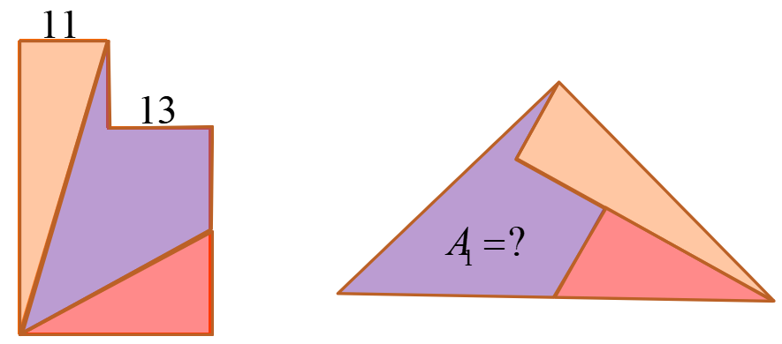
Q: Find the area of the following triangles:
Q2: The shape on the left is rearranged into a triangle shown on the left. Find the area of the purple solid:

Slide 14
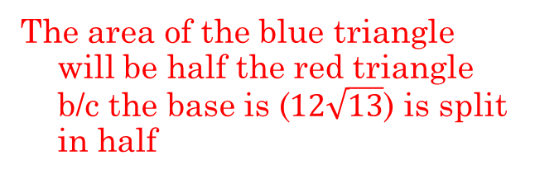
We don’t have the base nor the height. So let’s use “H’ as the height and “x” as part of the base
We have two right triangles, use the Pyth. Thm to solve for “x”
Subtract the two equations to get rid of the “H²”
X=18, now solve for “H”
The area of this green triangle is 216 units²
The area of this red triangle is also 216 units²
The area of the blue triangle will be half the red triangle b/c the base is ($12\sqrt{13}$) is split in half

Slide 15
This one is also a bit hard….. Try it first….

Slide 16
The shape on the left is rearranged into a triangle shown on the left. Find the area of the purple solid:

Slide 18
V) Altitude of the Hypotenuse (Right Triangles)
Use Pythagoras
to find the
hypotenuse!
Suppose “a” and “b” are the
height and base of a right triangle
Let “c” be the hypotenuse
Isolate the altitude
The altitude of the
triangle is 9.23 units

Slide 19
iii) Special Triangles
There are two types of special triangles:
  30°, 60°, 90° triangle (Equilateral Triangle) and
  45°, 45°, 90° triangle (Isosceles-Right Triangle)
Equilateral Triangle
Isosceles-Right Triangle
All sides and angles are equal
Two sides are equal and one angle
Is equal to 90°
Cut it in half
Use Pythagorean Thm. to find
the hypotenuse of the triangle
Use Pythagorean Thm. to find
the height of the triangle
Isoceles → 2 equal angles
© Copyright all rights reserved to Homework depot: www.BCMath.ca

Slide 20
IV) Areas of Equilateral Triangles
In an equilateral triangle, all sides and angles are equal
Pythagorus
The ratio of the side of a Eq. tri. to the height is:
The area is then equal to:

Slide 21
Ex: Use the to find the missing sides.
Correspond the sides with the special triangle
Find “k”

Slide 22
Ex: Find the missing lengths:
1. Special Triangle
2. Isosceles Triangle

Slide 23
Challenge: Given that area of the solid is 185 cm², Find the length of the diagonal
First find the length of each side
The larger square is 3cm longer
The sum of their areas is 185
Now find the length of all other sides
Use Pythagorus to find the diagonal
1st Method: Guess & Check
2nd Method: Expand & Factor

